Slide 1
Enhancing Data – Driven Decision- Making With Excel & Chatgpt
By Mansoor Shaikh.

Slide 2

What is Chatgpt?
Chatgpt is an artificial intelligence (AI) chatbot that uses natural language processing to create humanlike conversational dialogue. The language model can respond to questions and compose various written content, including articles, social media posts, essays, code and emails.

Slide 3

What is Excel?
MS excel is a commonly used Microsoft office application. It is a spreadsheet program which is used to save and analyse numerical data.

Slide 4

“Chatgpt Merge In Microsoft Excel”
Procedure:-
The first step is open Microsoft Excel.
Then click on the Insert tab and click on the Add-In option in the Insert tab.
Then a dialog box will open , then search AI and aided formula editor.

Slide 5
How To Use Chatgpt in Microsoft Excel?
Data Analysis: By integrating ChatGPT into Excel, you can automate data analysis tasks. You can use ChatGPT to generate commands for complex calculations, trend analysis, forecasting, and data visualization.
Data Entry: You can use ChatGPT for repetitive data entry tasks. Simply provide the input data, and ChatGPT can generate formulas to automate data entry.
Reports and Summaries: With ChatGPT in Excel, you can generate reports and summaries. Analyze your data and create summary reports, graphs, and charts.
Formula Suggestions: ChatGPT can provide suggestions for Excel formulas and functions. It can suggest the right formulas for data analysis.

Slide 6
Data Cleansing: You can use ChatGPT for data cleansing and data formatting tasks. If there are errors in your data, ChatGPT can help identify and correct them.
VBA Scripting: ChatGPT can assist in generating VBA (Visual Basic for Applications) scripts used for custom automation tasks in Excel.
Training and Learning: You can use ChatGPT to learn about advanced features and functions in Excel. By generating queries, you can get answers to specific Excel-related questions.

Slide 7
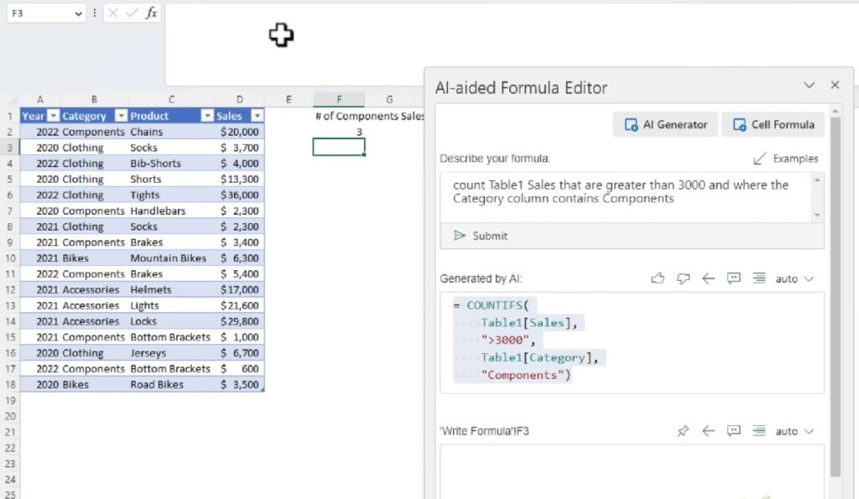
Example:-
Then I ordered AI to "Count table 1 under cells are greater than 3000 and wife were category column content component" then AI output the formula. Then as soon as I copied and pasted this formula into Excel, I got my information.

Slide 8
Conclusion:-
"Thus, the integration of ChatGPT with Excel represents a significant and commendable step forward. It offers valuable suggestions for data analysis and automation, simplifying data comprehension and utilization without complications. This opens new doors for data analysis and enriches our business and research endeavors with recommendations and tools, making tasks more accessible and efficient."

